Slide 1
4
Data
Visualization

Slide 2
Data Visualization
Data visualization is taking complex information and turning it into visual representations like charts, graphs, and maps. This makes it easier to understand trends, patterns, and relationships within the data. It's like translating a foreign language into something you can understand at a glance, allowing you to make data-driven decisions and communicate insights to others effectively.

Slide 3
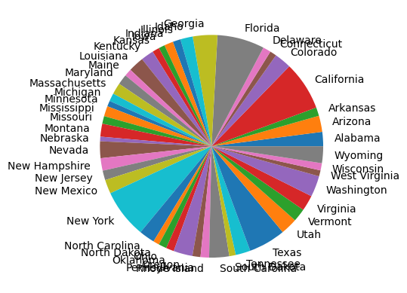

Slide 4
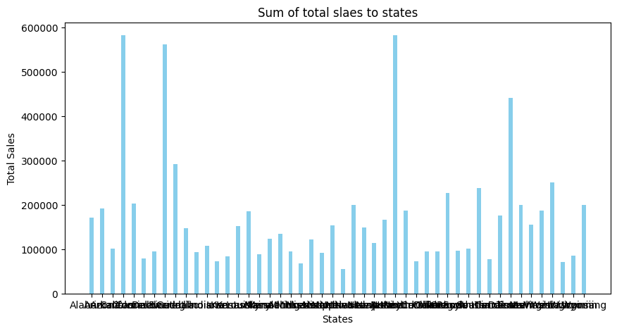

Slide 5
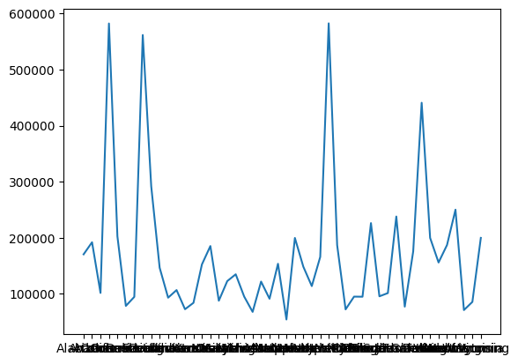

Slide 6
Feature | Python | Power BI
Category | General-purpose programming language | Business intelligence (BI) tool
Focus | Wide range of applications (data science, web development, automation) | Data analysis, visualization, and reporting
Learning Curve | Steeper learning curve, requires programming knowledge | Easier to learn for non-programmers, user-friendly interface
Data Manipulation | Highly flexible, extensive libraries for data cleaning, transformation, and analysis | Limited data manipulation capabilities, relies on pre-built functions
Data Visualization | Requires coding libraries like Matplotlib, Seaborn for visualizations | Offers a wide range of built-in charts and graphs, drag-and-drop functionality

Slide 7
Conclusion
Both Python and Power BI offer robust visualization capabilities, but cater to different user profiles and project requirements.
Python offers ultimate control, allowing you to create unique graphs and charts beyond predefined options.
Power BI is optimized for handling big data efficiently. Power Bi is more suited option for the visualization.

